Slide 1
22CS026
A college website
Team Members:
Pranzal yadav (2210992067)
Prajwal (2210992057)
Supervised By: Mr. Rahul Singh Rajput
Department of Computer Science and Engineering
Chitkara University, Punjab

Slide 2
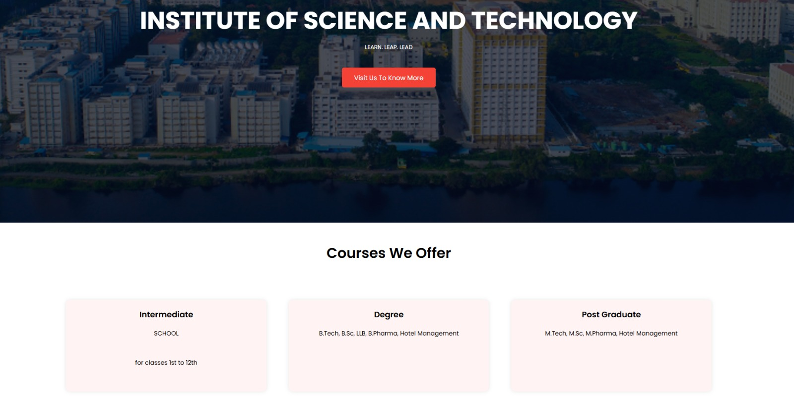
A college WEBSITE
Its time to educate ourselves

Slide 3
INTRODUCTION
College Website is a comprehensive project developed as part of a backend engineering initiative. This full-fledged website is designed to serve as a digital platform for colleges, facilitating seamless communication, information sharing, and management of academic activities.
Key Features:
Subjects and Courses:
A well-organized repository of subjects offered across various departments.
Course categories to help users easily navigate and explore programs based on their interests and academic requirements.
Student and Faculty Portals:
Secure, personalized access to information such as grades, schedules, and resources.
Tools for faculty to manage courses, assignments, and communication with students.
Centralized Information:
A platform for colleges to share news, announcements, and event updates with the community.

Slide 4
ABSTRACT
College Website is a comprehensive backend engineering project designed to streamline and enhance the academic and administrative processes of a college. This website serves as a centralized platform, offering features such as categorized course listings, detailed subject information, and personalized student and faculty portals.
Built on a robust backend architecture, the website facilitates efficient data management, secure user interactions, and seamless navigation. Key functionalities include dynamic subject and course categorization, a centralized system for news and announcements, and interactive tools for enhanced engagement.

Slide 5

PROBLEM STATEMENT
In today’s digital era, educational institutions often face challenges in managing and disseminating information efficiently. Colleges require a centralized platform to handle a wide range of tasks, including organizing course categories, providing detailed subject information, and facilitating communication between students and faculty.

Slide 6



TECHNICAL DETAILS
HTML:
Markup language for creating the structure of web pages.
Utilizes elements like <div>, <p>, <img> to organize content.
Forms for user input, with various input types like text, password, etc.
Semantics for accessibility and SEO.
CSS:
Style sheet language for styling HTML elements.
Box model for layout: content, padding, border, margin.
Selectors and specificity for targeting elements.
Layout techniques like positioning, display, flexbox, and grid.
Responsive design with media queries.
React JS:
Utilized for building the frontend user interface.
Component-based architecture for modularity and reusability.
Virtual DOM for efficient rendering and performance optimization.
Ensured compatibility across various devices and screen sizes

Slide 7



TECHNICAL DETAILS
Backend
MongoDB:
MongoDB is a source-available, cross-platform, document-oriented
database program.
MongoDB utilizes JSON-like documents with optional schemas.
MongoDB is developed by MongoDB Inc.
Express:
Express is a minimal and flexible Node.js web application framework
that provides a robust set of features for web and mobile applications.
Express is a lightweight and flexible routing framework with minimal
core features meant to be augmented through the use of Express middleware modules.
Postman:
Postman is a global software company that offers an API platform for developers to design, build, test, and collaborate on APIs.

Slide 8

KEY FEATURES
Student and Faculty Portals:
Secure, personalized access to information such
as grades, schedules, and resources.
Tools for faculty to manage courses, assignments,
and communication with students.
Centralized Information:
A platform for colleges to share news,
announcements, and event updates with the community.
Backend Engineering Excellence:
Powered by a robust backend system to handle
user data, manage course categories, and
ensure secure interactions.
Integration of APIs and a well-structured database
for smooth operations and scalability.

Slide 9

FUTURE SCOPE
Advanced Personalization:
Implement AI-driven recommendation systems to suggest courses, resources, and career paths based on user interests and academic performance.
Integration with Learning Management Systems (LMS):
Seamlessly connect with popular LMS platforms to facilitate online learning, assignment submissions, and grading.
Mobile Application:
Develop a companion mobile application to provide on-the-go access to the platform’s features, enhancing accessibility and user engagement.
Data Analytics and Reporting:
Integrate advanced analytics tools to provide insights into student performance, course popularity, and faculty engagement.
Generate automated reports for administrative decision-making.
Real-Time Communication Tools:
Add chat functionalities, discussion forums, and video conferencing tools to enhance collaboration between students and faculty.

Slide 10

CONCLUSION
The College Website project is a robust and scalable solution designed to address the academic and administrative challenges faced by educational institutions. By integrating features like course categorization, subject management, and personalized user portals, the platform enhances efficiency, accessibility, and user engagement. With its strong backend foundation and scope for future expansion, this project demonstrates the potential to evolve into a comprehensive digital hub, transforming the way colleges operate and interact with their communities.

Slide 11
SNAPSHOTS
HOME PAGE :

Slide 12
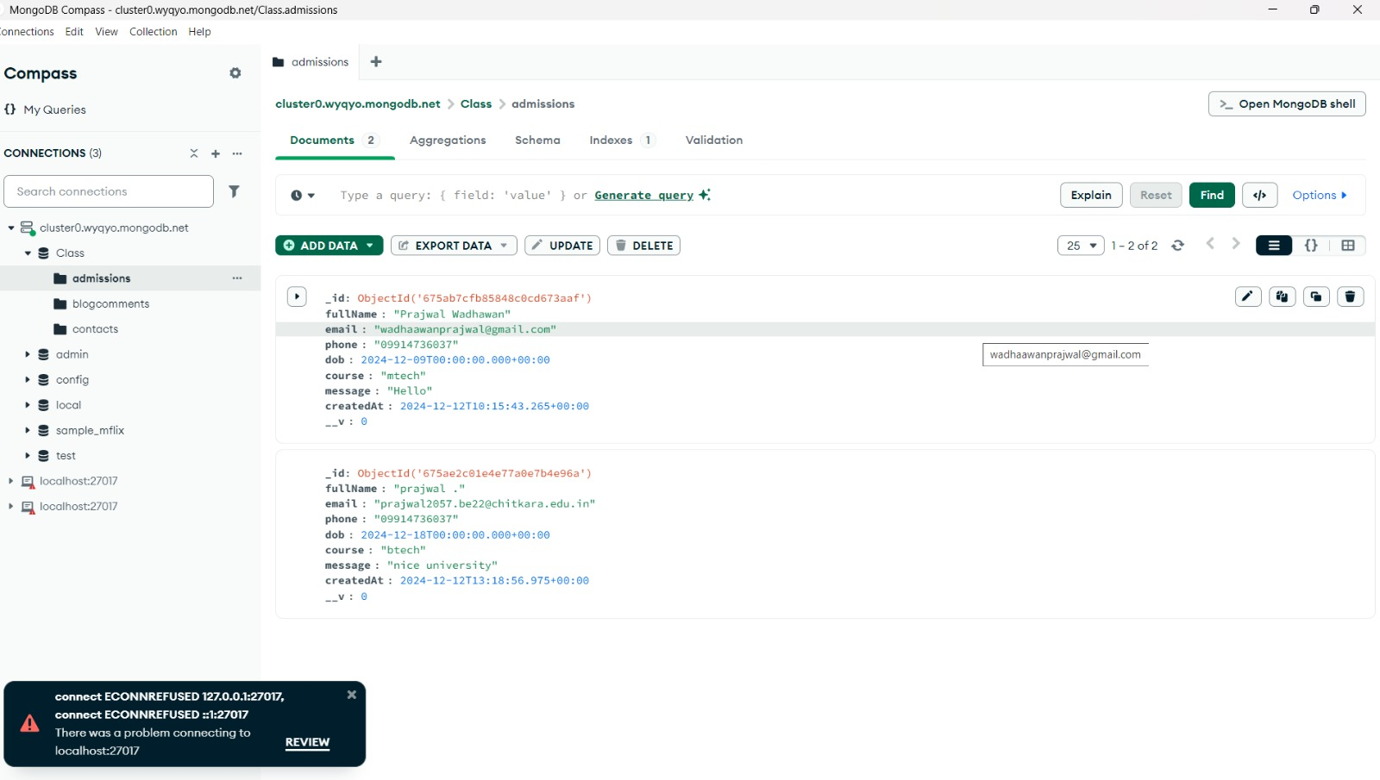
SNAPSHOTS
Backend data

Slide 13
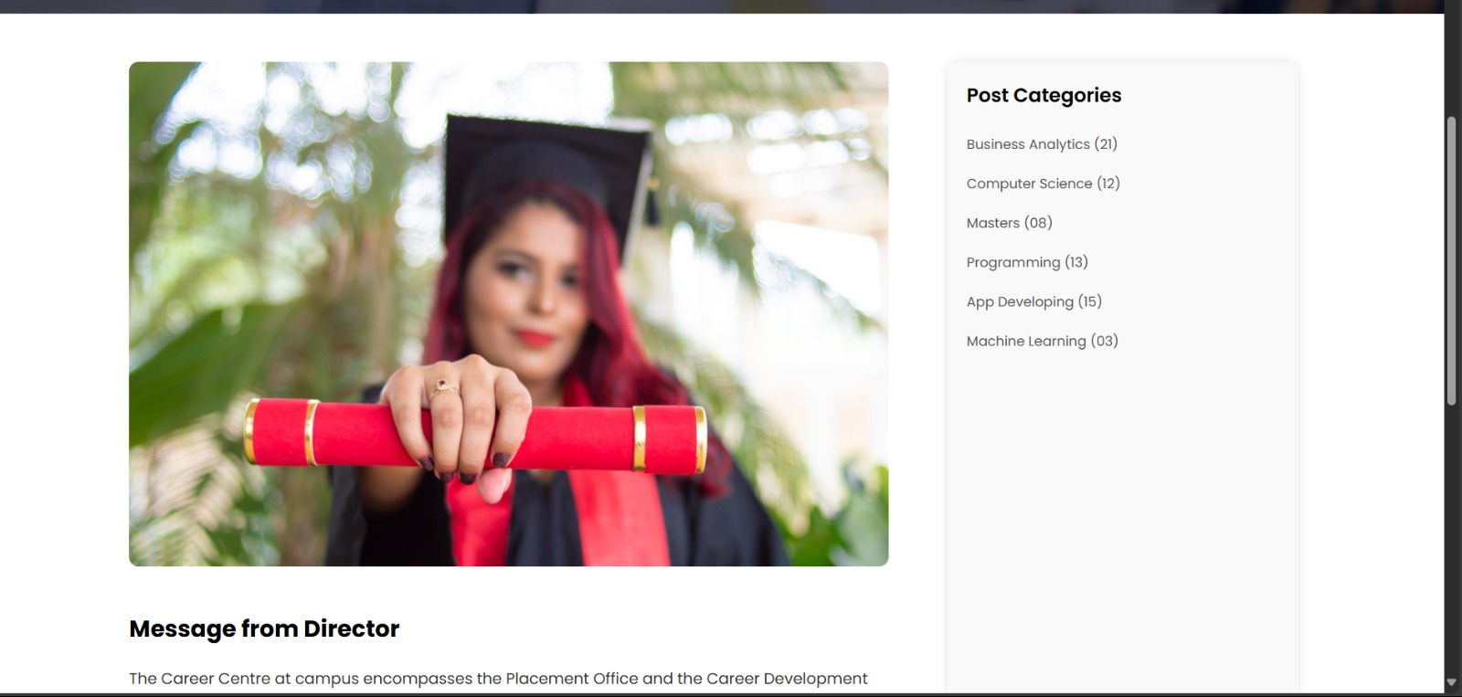
SNAPSHOTS
Message from director :

Slide 14
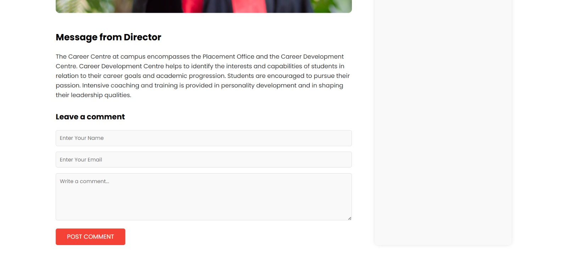
SNAPSHOTS
Contact Us and leave a comment :

Slide 15
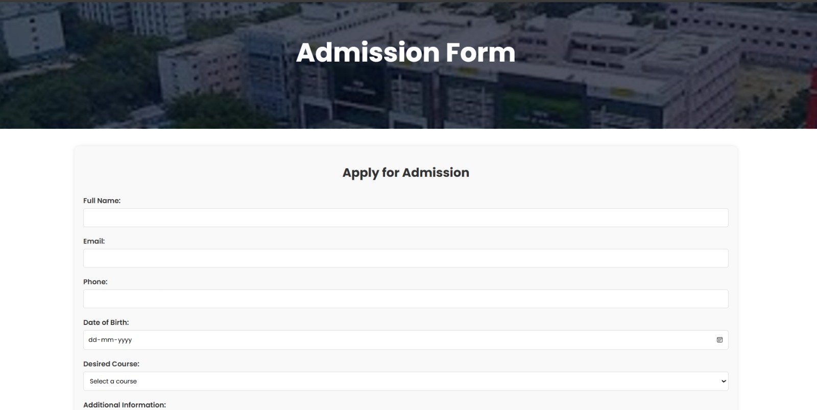
SNAPSHOTS
Login Page:

Slide 16
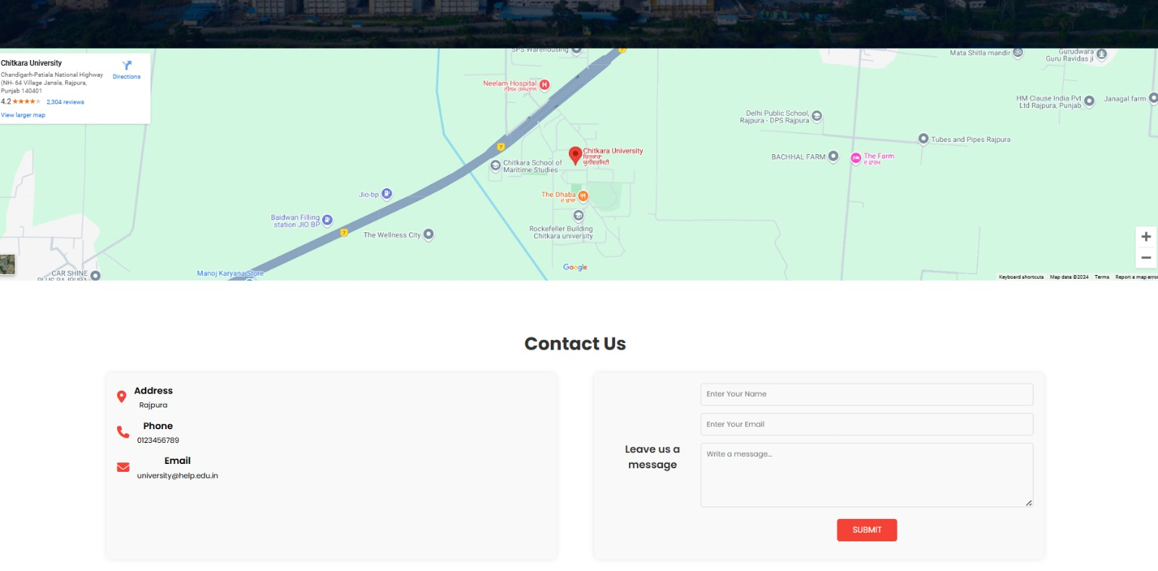
SNAPSHOTS
location API :

Slide 17
References/Links used:
https://github.com/Prajwal2716/College-Website
https://www.google.co.in/
https://https://github.com/pranzaly16/pranzal

Slide 18


